Slide 1
CSEN 601
Project Presentation
Done by: Team Molto (71)

Slide 2

Instruction Format
R-Type: opcode[0-3] rs [4-7] rt [8-11] rd [12-15]
I-Type: opcode[0-3] rs [4-7] rt [8-11] immediate [12-15]
S-Type: opcode[0-3] rs [4-7] rt [8-11] shamt [12-15]

Slide 3
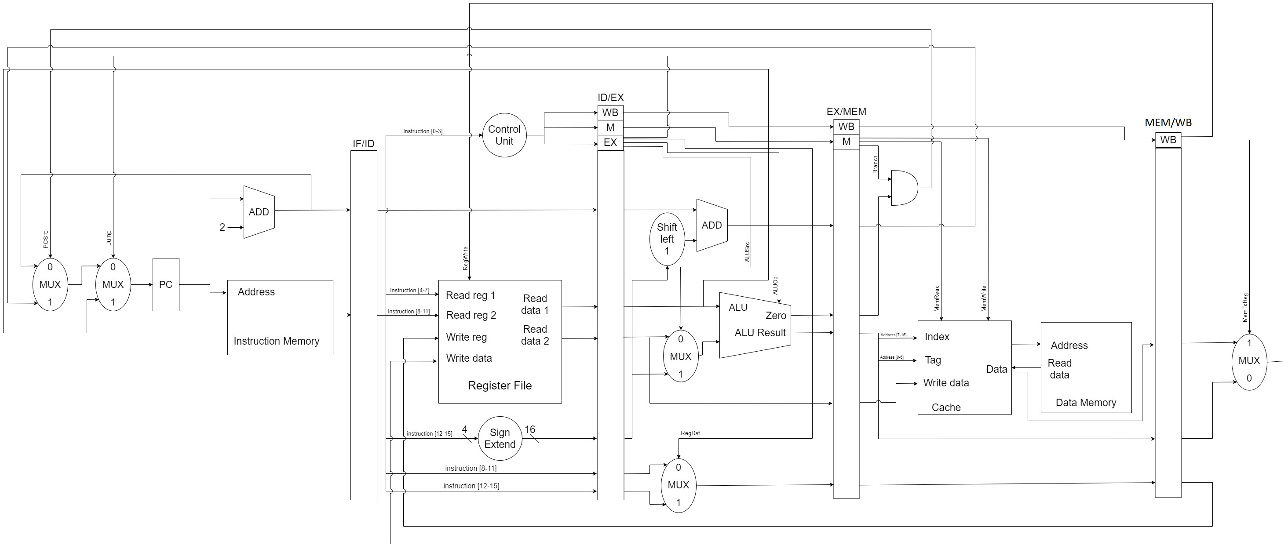
Datapath

Slide 4
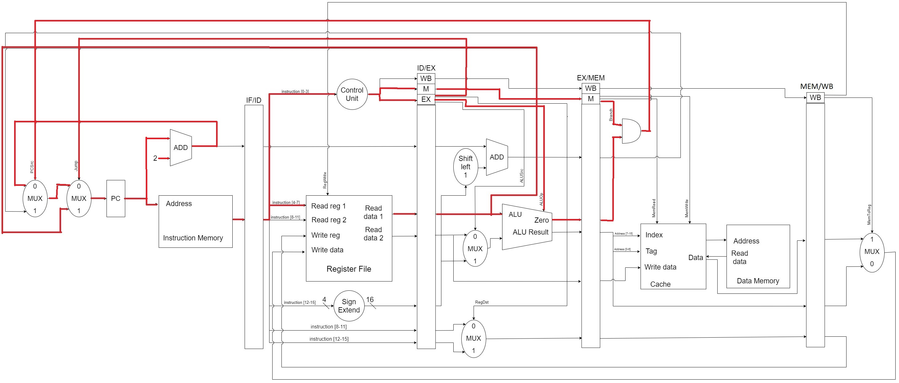
Jump Instruction (JR)

Slide 5
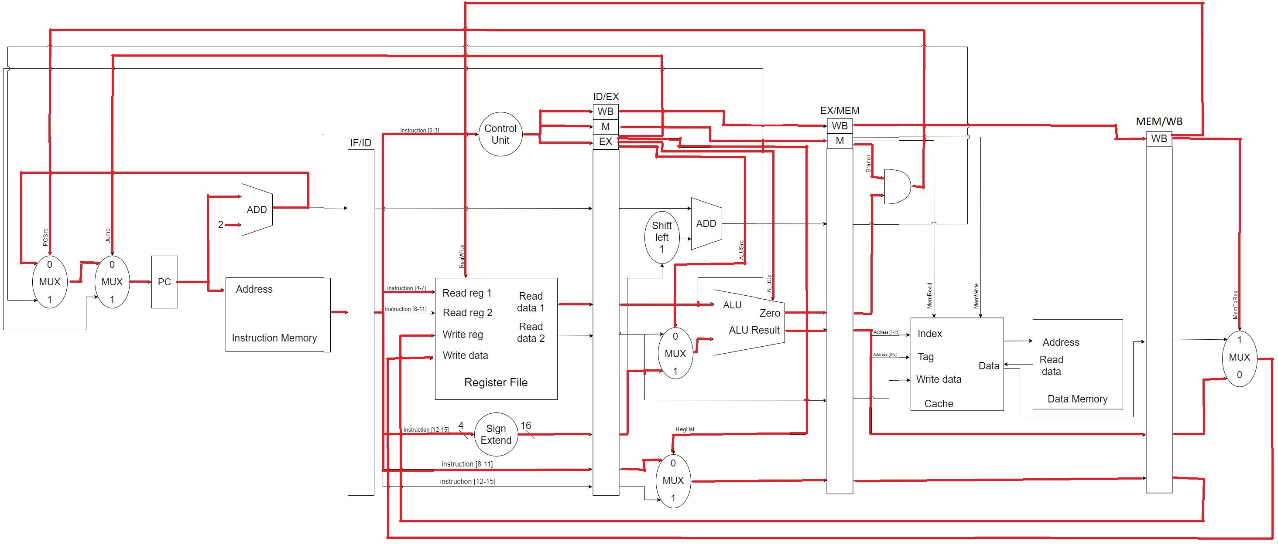
Shift Instruction (SLL)

Slide 6
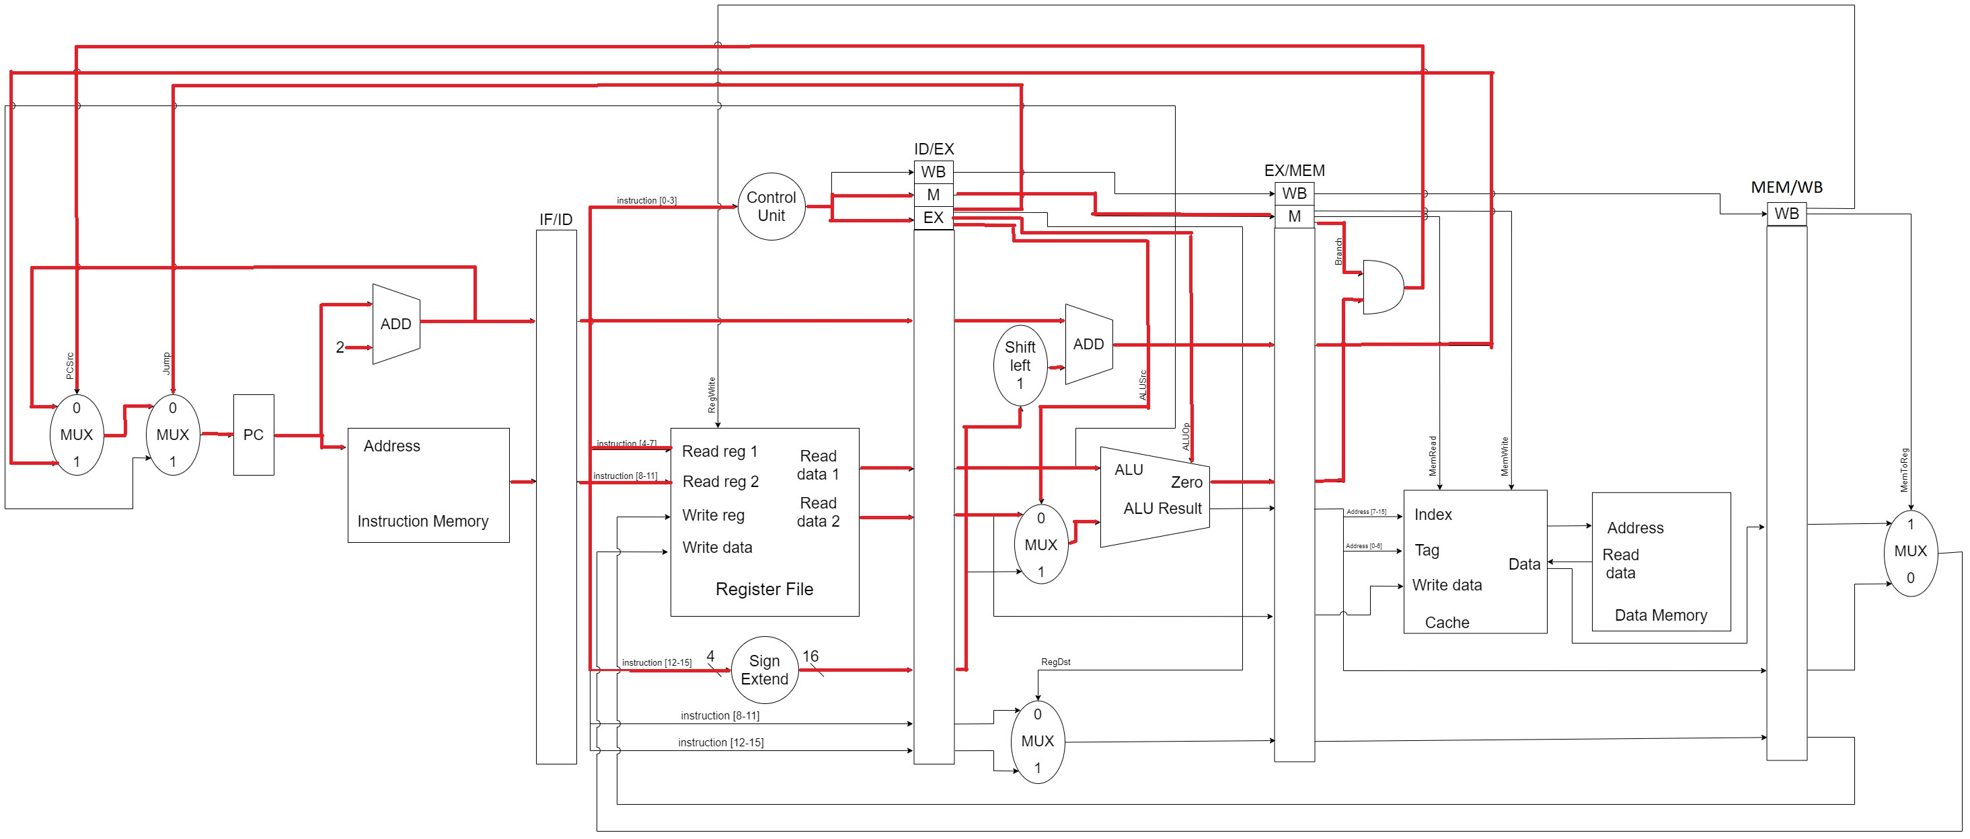
Branch Instruction (BEQ)

Slide 7
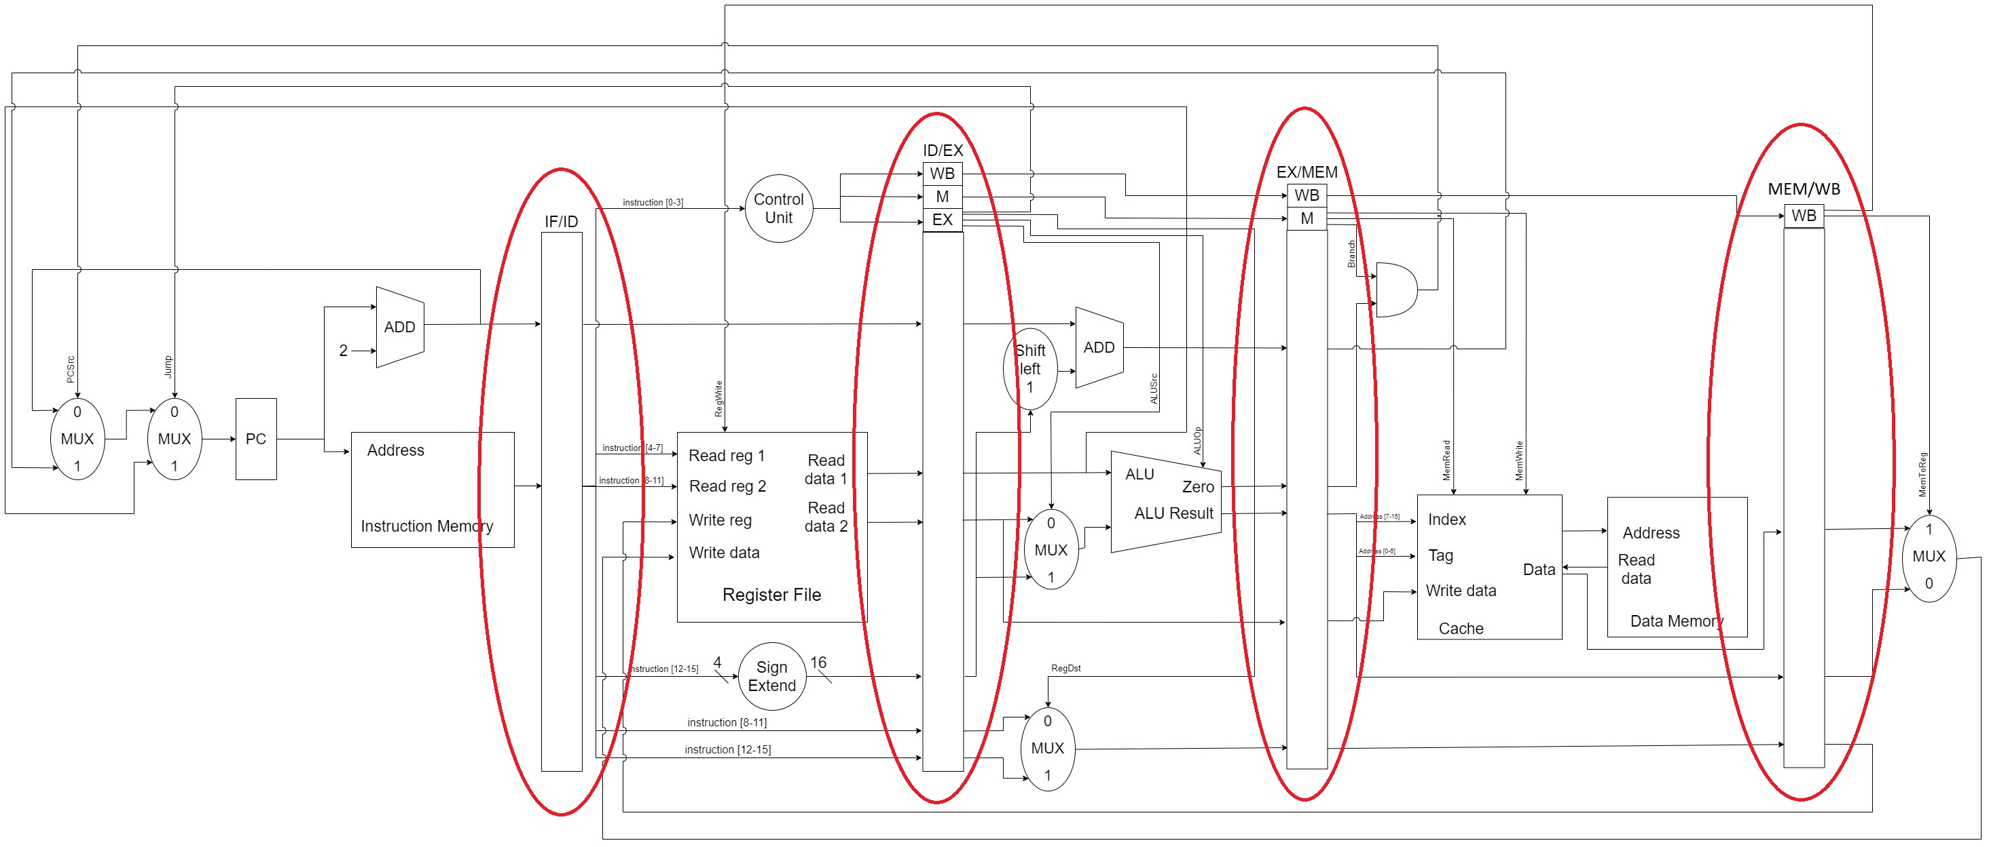
Pipelining

Slide 8
THANK YOU!

